Slide 1
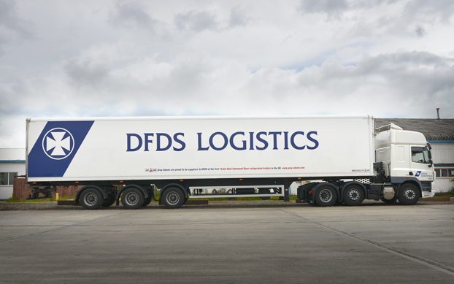
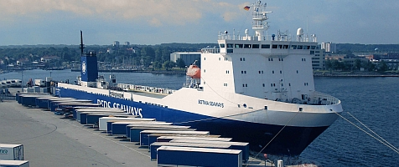

DFDS Trailer Allocation Tool
Processes, System & Business Case
Team TrailerOpt
CPH Hackathon 16-18th June 2017

Slide 2
Trailer Allocation Tool
Problem:
How can DFDS allocate trailers to transport tasks across Administrative Areas (Organizational silos) ?
Data on historical transports & orders
Daily Allocation Process
Allocated trailer orders
Visualize and predict trailer demand
Visualize overview of trailer state and position
Optimize & Allocate trailers to tasks based on criteria

Slide 3
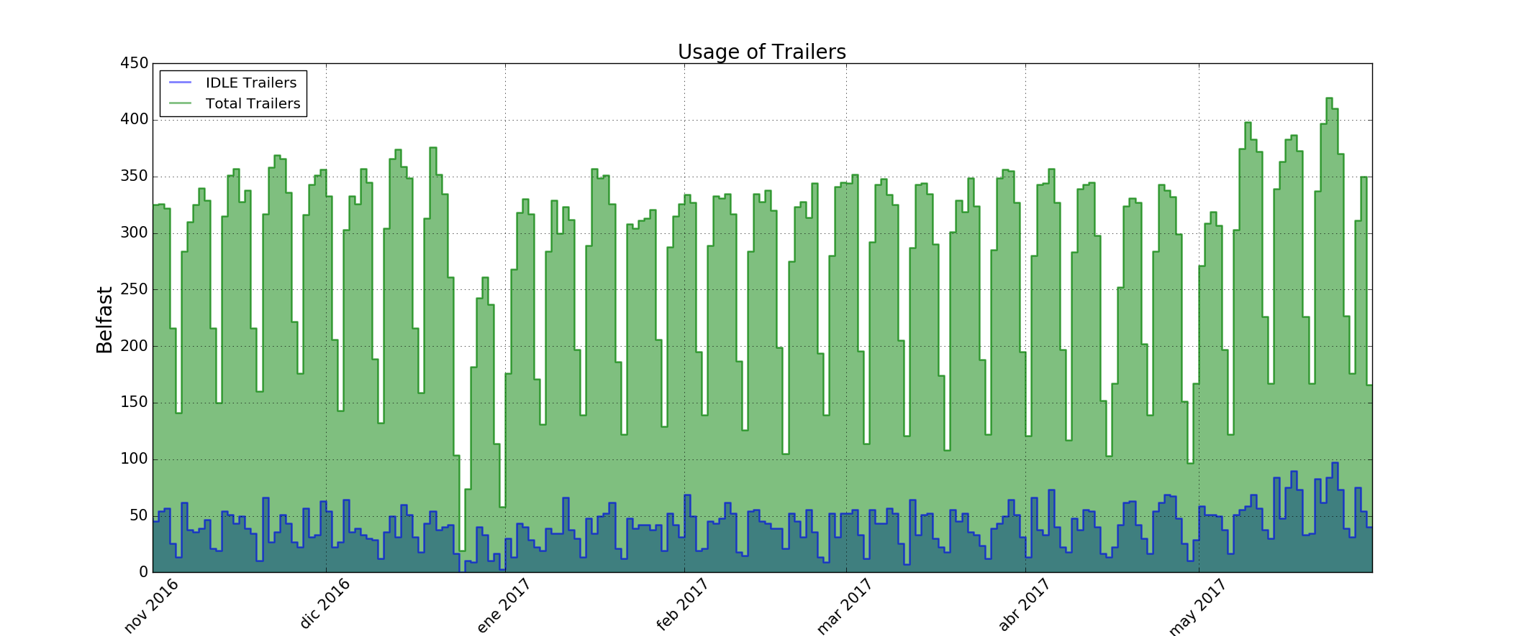
Current State – Trailer Idle Time
Trailers are in average idle 12,5% of the time
Admin Areas vary in their performance indicating improvement opportunity

Slide 4
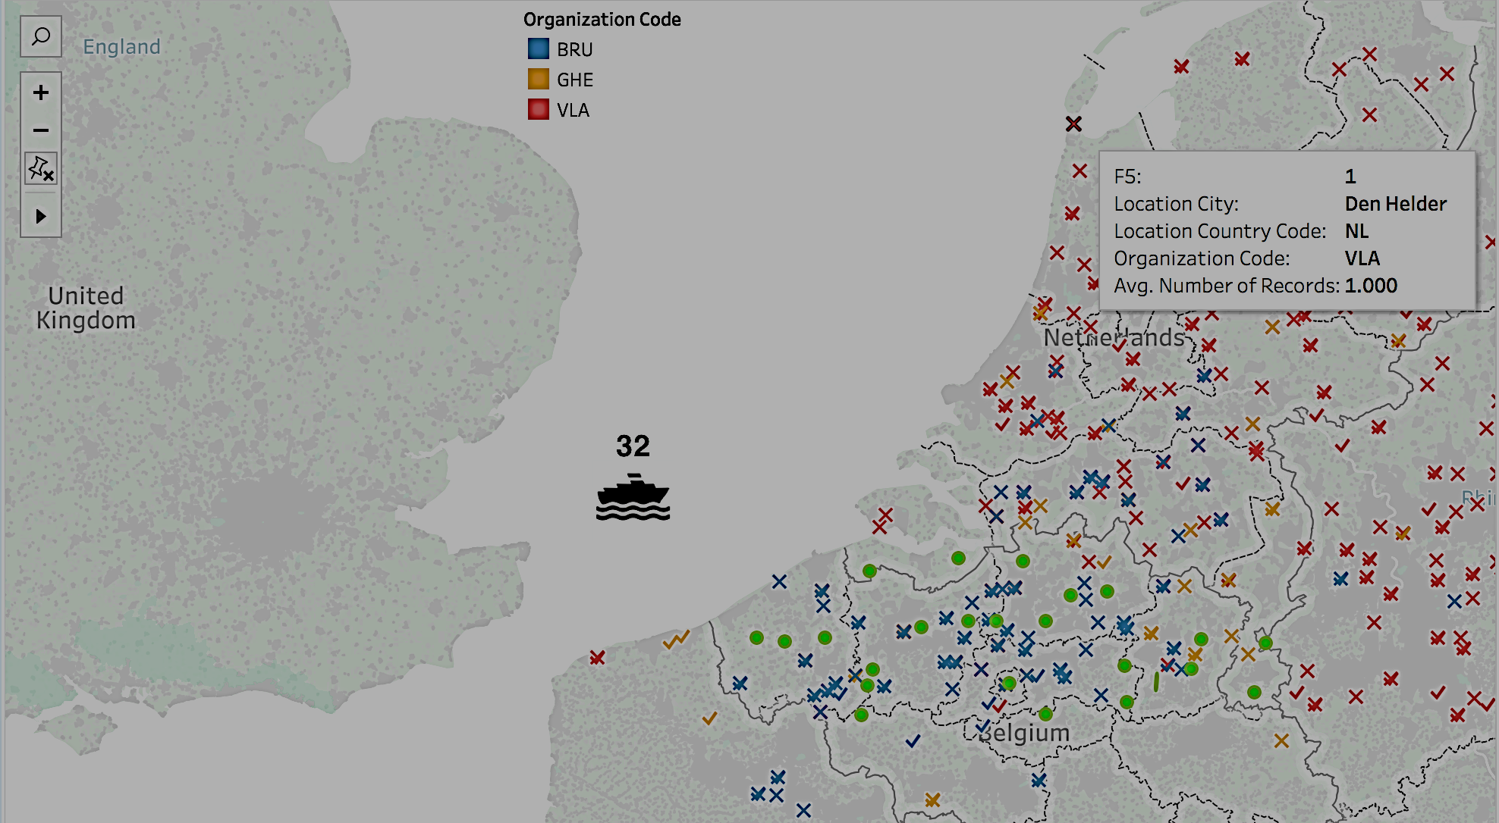
The Tool – Visualizing Opportunities

Slide 5
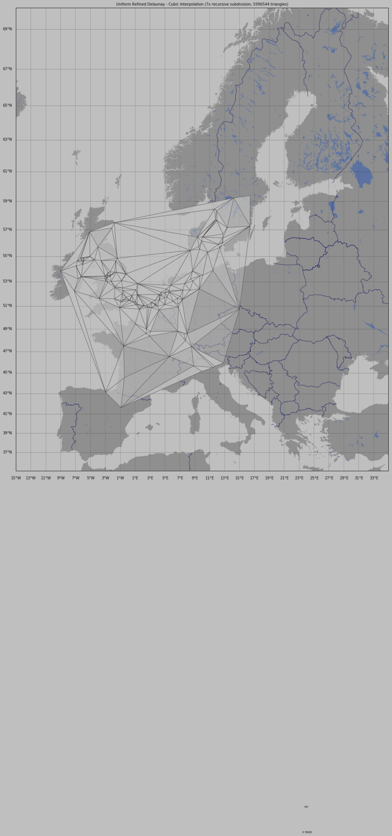
The Tool – Optimization

Slide 6
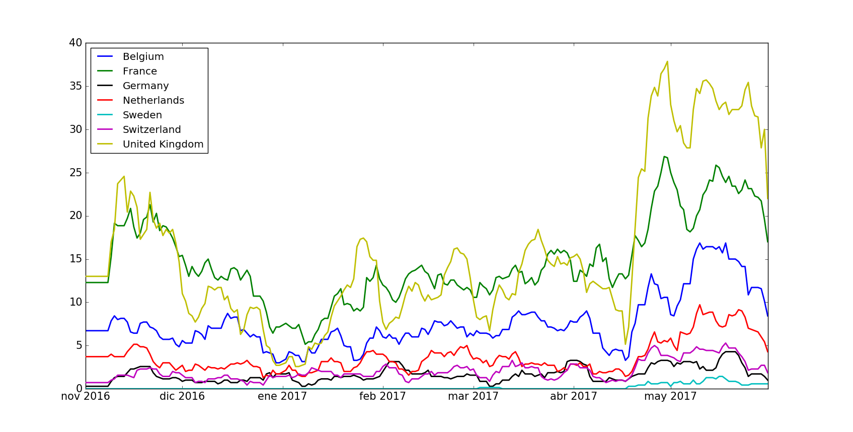
The Tool – Forecasting Model
No of Trailers
Day

Slide 7
Business Case
Investments for 2017: 1.500.000 EUR
--------------------------------------------------
Savings for 2018: 3.119.063 EUR

Slide 8
Next steps
Enable tool to optimize across all Admin Areas
Clarify if tool can support reduction of empty transports and not only idle trailers and driving KMs
Provide us and partners with 150.000 EUR to develop prototype for user testing
Do complete development for estimated 1.500.000 EUR
Potential Business Impact for Trailer based Road Transport Logistics Industry:
+10 million trailers in Europe
DFDS: 6.500 Trailers
EUR Potential of similar tool: DFDS Business Case x 100…..

